Slide 1
Building Android apps – Week 8b
2843-201710_MCS4993_M:Topics in MA/CS
2843-201710_MCS5993_M:Topics in Computer Science
Notes:
Look at the

Slide 2
Agenda
Chapter 13 HFAD – Services
Network access
Notes:
Think about what your app has to do when it opens a database. It first needs to go searching through the flash to find the database file. If the database file isn’t there, it needs to go create a blank database. Then it needs to run all of the SQL commands to create tables inside the database and any initial data it needs. Finally, it needs to fire off some queries to get the data out of there.That takes time. For a tiny database like the one used in the Starbuzz app, it’s not a lot of time. But as a database gets bigger and bigger, that time will increase and increase. Before you know it, your app will lose its mojo and will be slower than YouTube on Thanksgiving.

Slide 3
Notes:
We now know how to send a piece of text to the screen using a toast. That’s useful if we want to tell the user that, say, the very long download of a file has completed. But the truth is toasts don’t really stand out that much, and if you’re not looking at the screen at exactly the right moment, you don’t even see them. If we really want to keep the user informed about important stuff, we need to replace our toast with a notification.
Notifications are messages that appear in a list at the top of the screen. If the user doesn’t happen to see the notification at the time it was created, it doesn’t matter. She can still see them by dragging her finger down from the top of the screen to open the navigation drawer.
To send the notification, we’re going to use one of Android’s built-in services, the notification service.
Android comes with a number of built-in services that you can use in your app. These include the alarm service (used for controlling alarms), the download service (used for requesting HTTP downloads), and the location service (used for controlling location updates).
You use the notification service to manage notifications. We’ll give you an overview of how it will fit in with the app on the next page.

Slide 4
Notes:
How you use the notification service
Here’s an overview of how our app will work with the Android notification service:
1. MainActivity starts DelayedMessageService by passing it an intent.
2. DelayedMessageService creates a new Notification object.
The Notification object contains details of how the notification should be configured, such as its text, title, and icon.
3. DelayedMessageService creates a NotificationManager object to access Android’s notification service.
DelayedMessageService passes the Notification object to the NotificationManager, and the notification gets displayed.

Slide 5
Notes:
You create a notification using a notification builder to create a new Notification object. The notification builder allows you to create a notification with a specific set of features, without writing too much code. Each notification must include a small icon, a title, and some text.Here’s an example of the code you use to create a notification. It displays a high priority notification that vibrates when the notification appears and disappears once it’s clicked:
These are just some of the properties that you can set. You can also set things like visibility to control whether the notification will appear on the lock-screen, a number to display a count next to the notification in case you want to send many notifications from the same app, and a sound to make the notification make a noise.

Slide 6
Getting notification to start an activity
Create an Explicit Intent
Pass the Intent to the TaskStackBuilder
Get the Pending Intent from the TaskStackBuilder
Add the Intent to the Notification
Notes:
Getting your notification to start an activity
You get a notification to start an activity when it’s clicked using a pending intent. A pending intent is an intent an app can pass to other applications so that they can submit the intent on your app’s behalf at a later time.
Here are the steps you go through to create the pending intent:

Slide 7
Notes:
1. CREATE AN EXPLICIT INTENT
First, you create a simple explicit intent directed to the activity you want to start when the notification is clicked. In our case, we’ll start MainActivity:

Slide 8
Notes:
2. PASS THE INTENT TO THE TASKSTACKBUILDER
Next, we use a TaskStackBuilder to make sure that the back button will play nicely when the activity gets started. The TaskStackBuilder allows you to access the history of activities used by the back button. We need to get the back stack related to the activity, and then add the intent we just created to it:

Slide 9
FLAG | Description
FLAG_CANCEL_CURRENT | If a matching pending intent already exists, cancel it before generating a new one.
FLAG_NO_CREATE | If a matching pending intent doesn’t already exist, don’t create one and return null.
FLAG_ONE_SHOT | The pending intent can only be used once.
FLAG_UPDATE_CURRENT | If a matching pending intent already exists, keep it and replace its extra data with the contents of the new intent.
Notes:
Next, we get the pending intent from the TaskStackBuilder using its getPendingIntent() method. The getPendingIntent() method takes twoint parameters, a request code that can be used to identify the intent, and a flag that specifies the pending intent’s behavior.
Here are the different flag options:

Slide 10
Notes:
In our case, we’ll use FLAG_UPDATE_CURRENT to modify any existing pending intent. Here’s the code:

Slide 11
Notes:
4. ADD THE INTENT TO THE NOTIFICATION
Finally, you add the pending intent to the notification using the setContentIntent() method:

Slide 12
Notes:
Send the notification using the notification service
So far we’ve looked at how to create and configure a notification. The next thing is to pass it to the Android notification service so that it appears on the device.
You access Android’s built-in services using the getSystemService() method. It takes one argument, the name of the service you want to use.
The NOTIFICATION_ID is used to identify the notification. If we send another notification with the same ID, it will replace the current notification. This is useful if you want to update an existing notification with new information.
The notification service deals will all of the issues involved in a background service sending updates to the screen. This means that you no longer need to use a handler in order to update the user interface; the notification service handles it for

Slide 13
Notes:
Here’s the full code for DelayedMessageService.java. It now uses a notification instead of a toast to display a message:

Slide 15
Notes:
What happens when you run the code
1. MainActivity starts DelayedMessageService by passing it an intent.
The intent contains the message MainActivity wants DelayedMessageService to display.
2. DelayedMessageService waits for 10 seconds. 3. DelayedMessageService creates an intent for MainActivity.
4. DelayedMessageService creates a TaskStackBuilder and asks it to add the intent to MainActivity’s back stack.

Slide 16
Notes:
5. The TaskStackBuilder use the intent to create a pending intent and passes it to DelayedMessageService.
6. DelayedMessageService creates a Notification object, sets details of how it should be configured, and passes it the pending intent.
7. DelayedMessageService creates a NotificationManager object to access Android’s notification service and passes it the Notification.
8. When the user clicks on the Notification, the Notification uses its pending intent to start MainActivity.

Slide 17
Notes:
When you click on the button in MainActivity, a notification is displayed after 10 seconds. You’ll receive the notification irrespective of which app you’re in.

Slide 18
Notes:
When you click on the notification, Android returns you to MainActivity.
SHOW

Slide 19
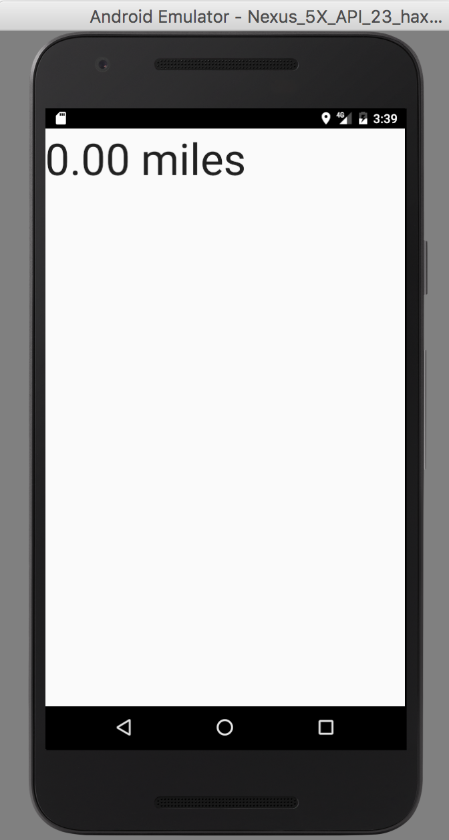
Notes:
Bound services are more interactive
As we said earlier, a started service runs in the background indefinitely, even when the activity that started it is destroyed. Once the operation is done, the service stops itself.
A bound service is bound to another component such as an activity. The activity can interact with it, send requests, and get results. To see this in action, we’re going to create a new app that uses a bound service that will work like an odometer to track the distance traveled by a vehicle.

Slide 20
Notes:
HOW THE ODOMETER APP WILL WORK
We’re going to create a new project with an activity called MainActivity, and a service called OdometerService.
MainActivity will useOdometerService to get the distance traveled.
1. MainActivity binds to OdometerService.
MainActivity uses the OdometerService getMiles() method to ask for the number of miles traveled.
2. The OdometerService uses the Android location services to keep track of when the device moves.
It uses these locations to calculate how far the device has traveled.
3. The OdometerService returns the distance traveled to MainActivity.
MainActivity displays the distance traveled to the user.

Slide 21
Steps to create OdometerService
Binder
Location
getMiles()

Slide 22
Notes:
1. Define an OdometerBinder.
A Binder object allows activities to bind to services. We’ll define a subclass of Binder called OdometerBinder that will enable our activity to connect to the OdometerService.
2. Create a LocationListener and register it with Android’s location service.
This will allow the OdometerService to listen for changes in the device location and work out the distance traveled in meters.
3. Create a public getMiles() method.
The activity will be able to use this to get the number of miles traveled.

Slide 23
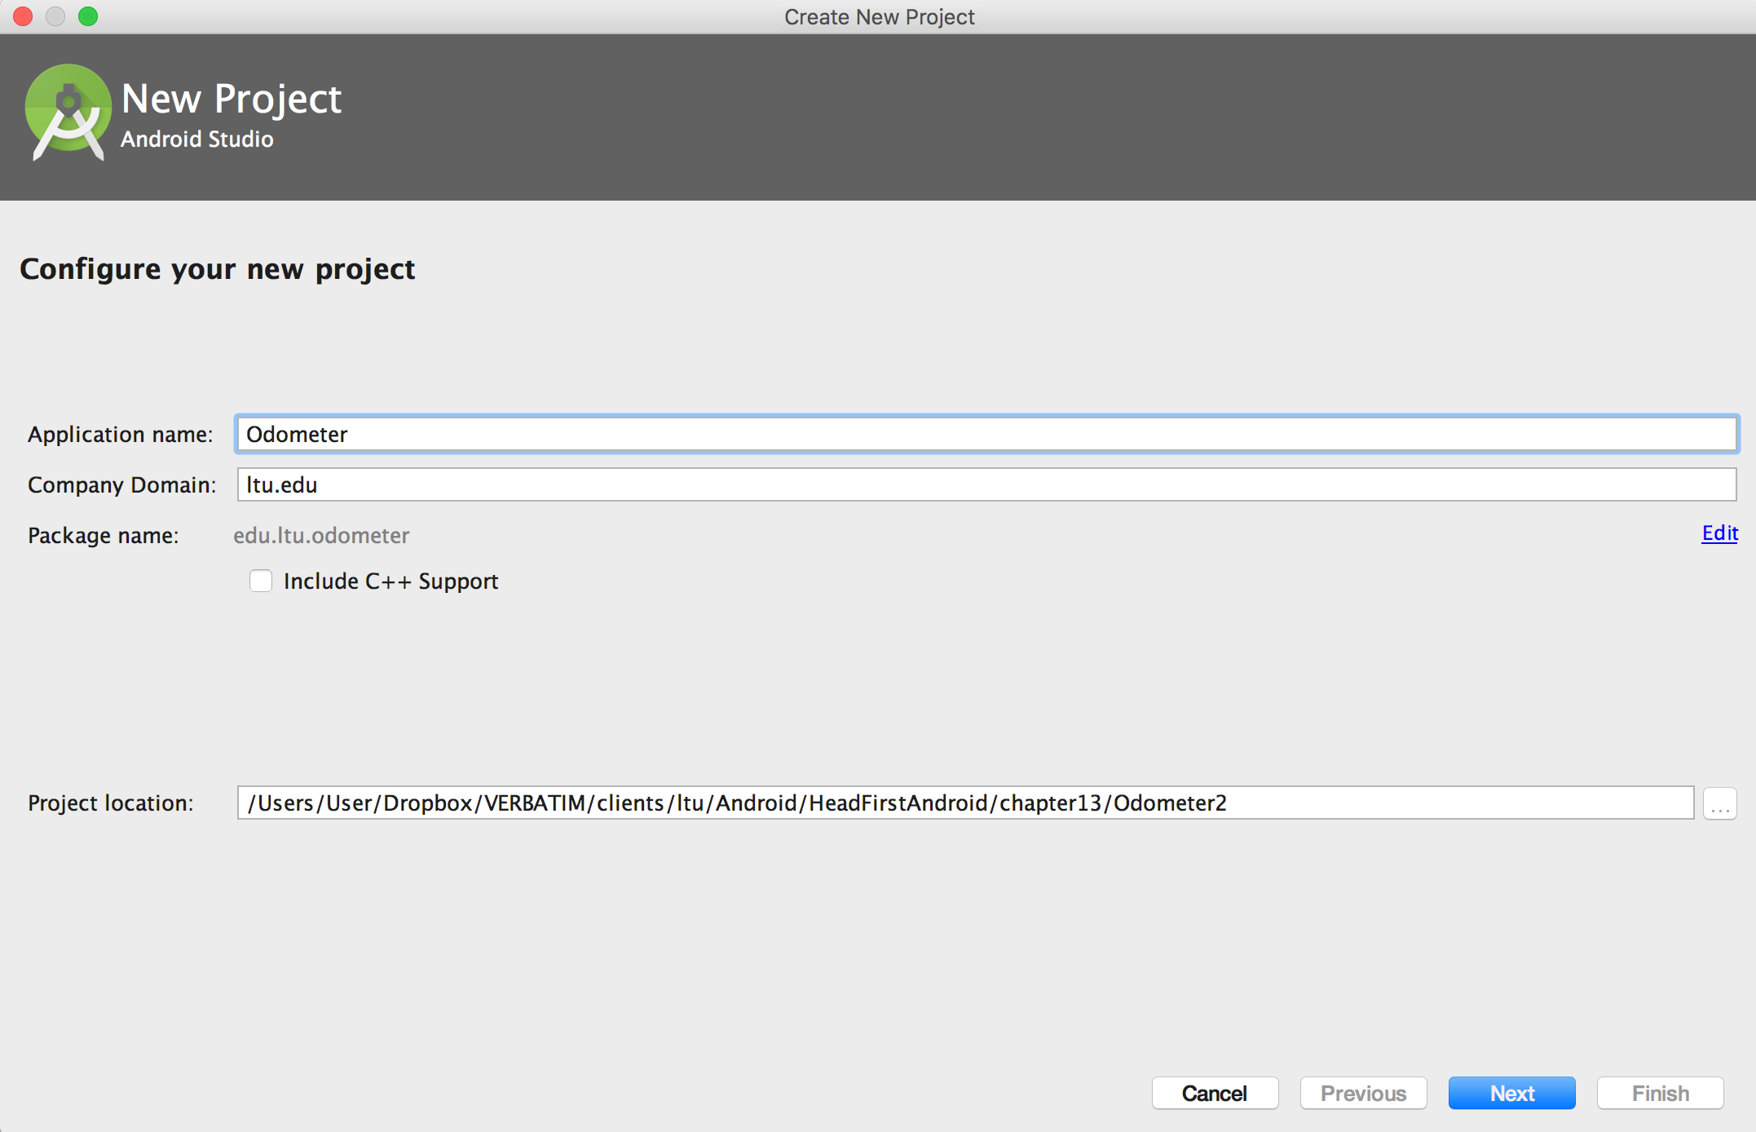
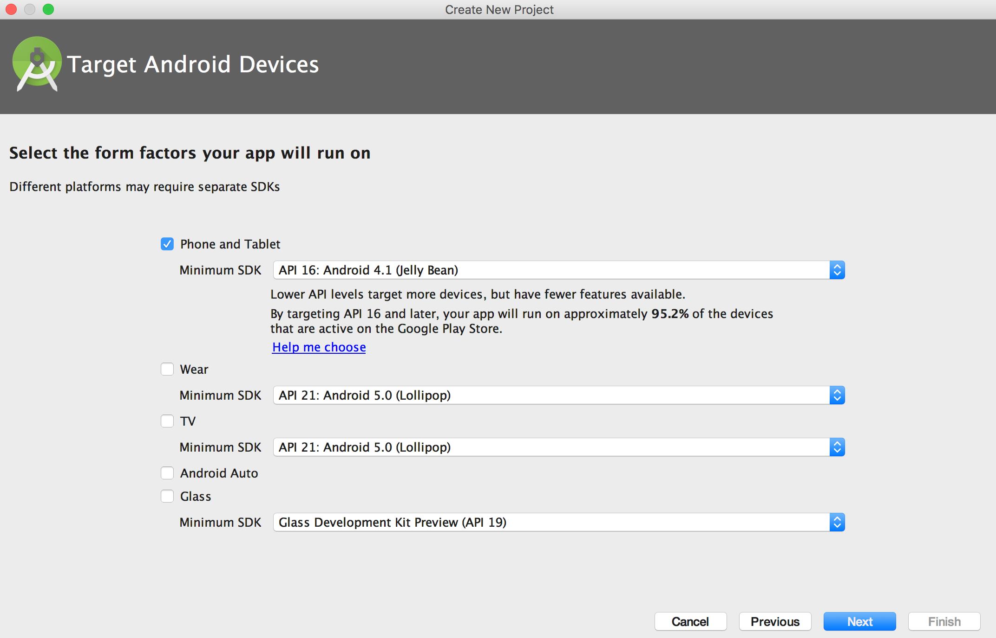
Notes:
Create a new Odometer project
Create a new Android project for an application named “Odometer” with a package name of com.hfad.odometer. The minimum SDK should be API 16 so that it will work with most devices. You’ll need a blank activity called “MainActivity” and a layout called “activity_main” so that your code matches ours.

Slide 24
Notes:
We’re going to add a new service to the project. This time we’re going to use a service that extends the Service class and not the IntentService class. This is because the IntentService class is intended for services that handle intents, as we did in the previous example. In this case, we’re going to start the service by binding to it so there’s no advantage in using the IntentService class.

Slide 25
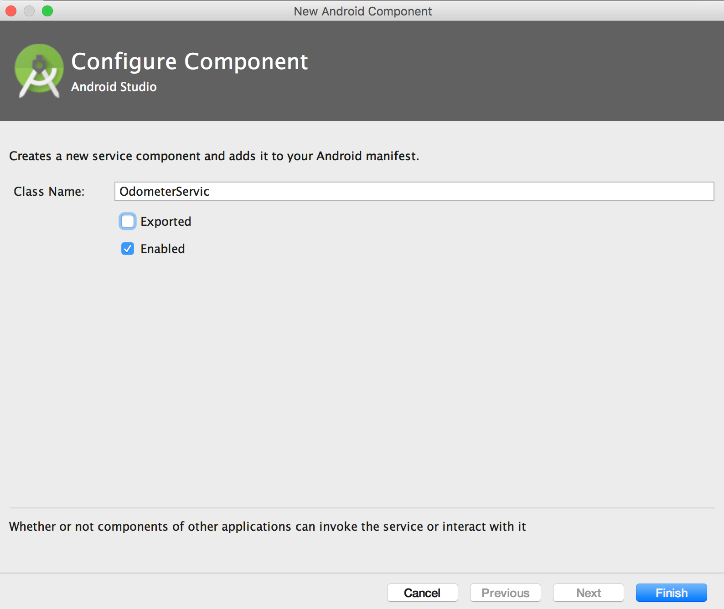
Notes:
You add a service that extends the Service class in a similar way to how we added a service earlier. Go to File→New... and select the Service option. When prompted, choose the option to create a new Service (not an IntentService), and give the service a name of “OdometerService”. Untick the “exported” option as this only needs to be true if you want services outside this app to access the service. Make sure that the “enabled” option is ticked; if it isn’t, the activity won’t be able to run the app.

Slide 26
Notes:
The onBind() method is used to bind the service to an activity.

Slide 27
Notes:
The activity creates a ServiceConnection object.
A ServiceConnection is used to form a connection with the service.
The activity passes an Intent down the connection to the service.
The intent contains any additional information the activity needs to pass to the service.
The bound service creates a Binder object.
The Binder contains a reference to the bound service. The service sends the Binder back along the connection.
When the activity receives the Binder, it takes out the Service object and starts to use the service directly.

Slide 28
Notes:
Define the Binder
When an activity asks to bind to a service using a service connection, the connection calls the onBind() method of the service.
The onBind() method returns aBinder back to the connection. This is then passed back to the activity.
When you create a bound service, you need to define the Binder yourself. We’re going to define a Binder called OdometerBinder by declaring it as an inner class like this:

Slide 29
Notes:
We’ll then return an instance of the OdometerBinder in the service onBind() method:
When the activity binds to the service with a service connection, the connection will call the onBind() method, which will return the OdometerBinder object. When the activity receives the OdometerBinder from the connection, it will use the getOdometer() method to get the OdometerService object.
THAT’S BINDER DONE

Slide 30
Notes:
The next thing we need to is get our service to do something. We want our service to be able to tell the activity how far the device has traveled.
There are two things we need to do to enable this:
Set up a listener when the service gets created that will listen for changes in the device location.
Return the number of miles traveled to the activity whenever the activity asks for it.

Slide 31
Method | When it’s called | What you use it for
onCreate() | When the service is first created | One-time setup procedures, such as instantiation
onStartCommand() | When an activity starts the service using the startService() method | You don’t need to implement this method if your service isn’t a started service; it will only run if the service is started using startService()
onBind() | When an activity wants to bind to the service | You must always implement this method by returning an IBinder object; if you don’t want activities to bind to the service, return null instead
onDestroy() | When the service is no longer being used and is about to be destroyed | Use this method to clean up any resources
Notes:
The Service class has four key methods
We’re creating a bound service that extends the Service class. The Service class has four key methods that you might want to use:

Slide 32
Notes:
In our case, we want to start getting location updates when the service is created.
As this is a one-time setup, we’ll do this in the onCreate() method:

Slide 33
Notes:
If you want to find out the location of your device, you use the Android location service.
The location service uses information from the GPS system and the names and strengths of nearby WiFi networks to find your location on the surface of the Earth.
You start by creating a LocationListener. A location listener is used for getting updates on when the device location has changed.
You create the location listener like this:
To keep track of distances in location, you need to override the Location Listener onLocationChanged() method.
This method has one parameter, a Location object that represents the device current location.

Slide 34
double distanceInMeters = location.distanceTo(lastLocation);
Notes:
You can find the distance in meters between two locations using the Location distanceTo() method.
As an example, if you use a Location object called lastLocation to record the device’s last location, you can find the distance in meters between the locations using:

Slide 35
Notes:
Now that we’ve created a listener, we need to register it with the location service.

Slide 36
Notes:
You register the location listener with the Android location service using a LocationManager object.
A location manager gives you access to the location service, and you create one like this:
The getSystemService() method returns a reference to a system level service. In this case, we want to use Android’s location service, so we use:
getSystemService(Context.LOCATION_SERVICE);

Slide 37
Notes:
Once you have a location manager, you can use its requestLocationUpdates() method to register the location listener with the location service, and specify criteria for how often you want the listener to get updated. The requestLocationUpdates() method takes four parameters: a GPS provider, the minimum time interval between location updates in milliseconds, the minimum distance between location updates in meters, and a LocationListener.
Here’s how you’d use the method to get updates every second when the device has moved more than a meter:

Slide 38
Notes:
We can use this in the Service onCreate() method to register the listener we created with the location service and make sure it gets regular updates. Here’s the code:
That’s everything we need to register the listener with the location service and get it to keep track of the distance traveled. Next, we need to get it to report back to the activity.

Slide 39
Notes:
Tell the activity the distance traveled
If you remember, there were two things we needed our service to do.
The first thing we needed was to get it to keep track of the distance traveled by the device. We’ve now done this by creating a location listener and registering it with the location service.
The second thing we need is to get the service to tell the activity how far the device has traveled so that it can tell the user. To do this, we’ll create a simple getMiles() method in the service that converts the current distance traveled into miles. The activity will call this method whenever it want to know the distance.

Slide 40
Notes:
The method takes the current distance traveled in meters, then divides it by 1609.344 to get the distance traveled in miles.
That’s everything we need for our OdometerService.java code. We’ll show you the full code on the next page.

Slide 43
Notes:
When you create an app, Android allows you to perform most actions by default. But there are some actions that Android needs the user to give permission for in order for them to work correctly.
One of these actions is using the device GPS. If your app needs to use the device GPS, the user needs to give permission when the app is installed.
You tell Android that your app needs permission to use the GPS using the <uses-permission> element like this:
If you don’t include this permission in AndroidManifest.xml, the app will crash.

Slide 44
Notes:
You also need to check that Android Studio has added your service to AndroidManifest.xml:

Slide 45
Notes:
Where we’ve got to
Let’s look again at what we want our app to do so we can see what’s left:
MainActivity binds to OdometerService.
MainActivity uses the OdometerService getMiles() method to ask for the number of miles traveled.
The OdometerService uses the Android location services to keep track of when the device moves.
It uses these locations to calculate how far the device has traveled.
The OdometerService returns the distance traveled to MainActivity.
MainActivity displays the distance traveled to the user.

Slide 46
Update MainActivity
Bind to service
Display miles
Notes:
So far we’ve created the OdometerService. It uses the Android location services to track locations, and uses this to calculate the distance traveled.
The next thing we need to do is create MainActivity. We need to get it to bind to OdometerService, and then use the OdometerService getMiles()method to display the distance the device has traveled.

Slide 47
Notes:
We need to get MainActivity to use the service to display the number of miles traveled, so we’ll start by updating the layout file activity_main.xml. We’ll add a text view to the layout that we can use to display the mileage. We’ll update the text view every second in our Java code.

Slide 48
Notes:
Next, we need to update the activity code so that it binds to the service and updates the text view.
We already know how to update views, but what we don’t know is how to bind to the service. Let’s see how it’s done.
Create a ServiceConnection
Earlier on in the chapter, we said that an activity binds to a service using a ServiceConnection object. A ServiceConnection is an interface with two methods: onServiceConnected() and onServiceDisconnected().
The onServiceConnected() method is called when a connection to the service has been established and a Binder object is received from the service.
You can use the binder to get a reference to the service.
The onServiceDisconnected() method is used when the connection to the service has been lost.
When you need an activity to bind to a service, you need to create your own implementation of the ServiceConnection. Here’s ours:

Slide 49
Notes:
When the service is connected, the onServiceConnected() method uses the Binder object to get a reference to the service.
We’re also using the onServiceConnected() and onServiceDisconnected() methods to record whether the service is currently connected.

Slide 50
Notes:
We’re going to use the connection to bind to the service when the activity becomes visible. As a reminder, when an activity becomes visible, its onStart() method gets called.

Slide 51
Notes:
To bind to the service, you first create an explicit intent that’s directed at the service you want to bind to.
You then use the activity’s bindService() method to bind to the service: The code Context.BIND_AUTO_CREATE tells Android to create the service if it doesn’t already exist.

Slide 52
Notes:
When the activity loses visibility, we’re going to unbind from the service. When an activity loses visibility, its onStop() method gets called.

Slide 53
Notes:
You unbind from the service using the unbindService() connection. The method takes one parameter, our connection.
We’re going to check whether the service is bound when the activity loses visibility, and if it is, we’ll unbind it:
So far we have an activity that binds to the service when the activity starts, and unbinds from the service when the activity stops.
The final thing we need to do is get the activity to ask the service for the distance traveled.

Slide 54
Notes:
Once you have a connection to the service, you can call its methods. We’re going to call the OdometerService getMiles() method every second to get the distance traveled, and then use it to update the text view in the layout. We’ll call the getMiles() method every second and update the text view each time it’s called.
To do this, we’re going to write a new method called watchMileage(). This works in exactly the same way as the runTimer() method we used in Chapter 4. The only difference is that it displays miles traveled instead of elapsed time.

Slide 55
Notes:
Here’s our watchMileage() method:
We’ll then call this method in the activity’s onCreate() method so that it starts running when the activity gets created:
@Override protected void onCreate(Bundle savedInstanceState) {
...
watchMileage();
}

Slide 58
Notes:
1. When the MainActivity starts, the onStart() method creates a ServiceConnection.
It asks to bind to the OdometerService.
2. The OdometerService starts and its onBind() method is called with a copy of the intent from the MainActivity.
3. The onBind() method returns a Binder object.
4. MainActivity gets a reference to OdometerService from the Binder and starts to use the service directly. 5. While MainActivity is running, the watchMileage() method calls the OdometerService getMiles() method every second and updates the screen.
6. When MainActivity stops, it disconnects from the OdometerService by calling unbindService().

Slide 59
Notes:
To see the app in action, you’ll need to run it on a device that has a GPS. If you don’t, the app won’t work.
When you start the app, it says the distance traveled is 0 miles. An icon appears at the top of the device indicating that the location service has been activated:

Slide 60
Bullet Points
A service is a component that can perform tasks in the background. It doesn’t have a user interface.
A started service can run in the background indefinitely, even when the activity that started it is destroyed. Once the operation is done, it stops itself.
You declare services in AndroidManifest.xml using the <service> element.
You can create a simple started service by extending the IntentService class and overriding its onHandleIntent() method. The IntentServiceclass is designed for handling intents.
You start a started service using the startService() method.
If you override the IntentService onStartCommand() method, you must call its super implementation.
You create a notification using a notification builder. You get your notification to start an activity using a pending intent. You then use Android’s notification service to display the notification.
A bound service is bound to another component such as an activity. The activity can interact with it and get results.

Slide 61
Bullet Points
You usually create a bound service by extending the Service class. You must define your own Binder object, and override the onBind() method. This is called when a component wants to bind to the service.
The Service onCreate() method is called when the service is created. Use it for instantiation.
The Service onDestroy() method is called when the service is about to be destroyed.
You can use the Android location service to get the current location of the device. You create a LocationListener, and then register it with the location service. You can add criteria for how often the listener is notified of changes. When you use the device GPS, you need to add a permission for it inAndroidManifest.xml.
To bind an activity to a service, you create a ServiceConnection. You override the onServiceConnected() method to get a reference to the service.
You bind to the service using the bindService() method. You unbind from the service using the unbindService() method.

Slide 62
Network Access
Choosing HTTP Client
Apache HTTP client
Java’s HttpURLConnection
Volley
Retrofit
Notes:
HTTP is dead and gone

Slide 63
HTTPUrlConnection
URL url = new URL("http://www.android.com/");
HttpURLConnection urlConnection = (HttpURLConnection) url.openConnection();
InputStream in = new BufferedInputStream(urlConnection.getInputStream());
readStream(in);

Slide 64
HTTPUrlConnection
URL url = new URL(urlString);
HttpURLConnection conn = (HttpURLConnection) url.openConnection(); conn.setReadTimeout(10000 /* milliseconds */);
conn.setConnectTimeout(15000 /* milliseconds */); conn.setRequestMethod("GET");
conn.setDoInput(true);
// Start the query
conn.connect();
InputStream stream = conn.getInputStream();
return stream;
Notes:
1. Obtain a new HttpURLConnection by calling URL.openConnection() and casting the result to HttpURLConnection.
2. Prepare the request. The primary property of a request is its URI. Request headers may also include metadata such as credentials, preferred content types, and session cookies.
3. Optionally upload a request body. Instances must be configured with setDoOutput(true) if they include a request body.
4. Transmit data by writing to the stream returned by getOutputStream().
5. Read the response. Response headers typically include metadata such as the response body's content type and length, modified dates and session cookies. The response body may be read from the stream returned by getInputStream(). If the response has no body, that method returns an empty stream.
6. Disconnect. Once the response body has been read, the HttpURLConnection should be closed by calling disconnect(). Disconnecting releases the resources held by a connection so they may be closed or reused.

Slide 65
Network Access
Google Example
https://github.com/googlesamples/android-NetworkConnect
Fetch raw HTML using HttpURLConnection
AsyncTask used to fetch on background task.

Slide 66
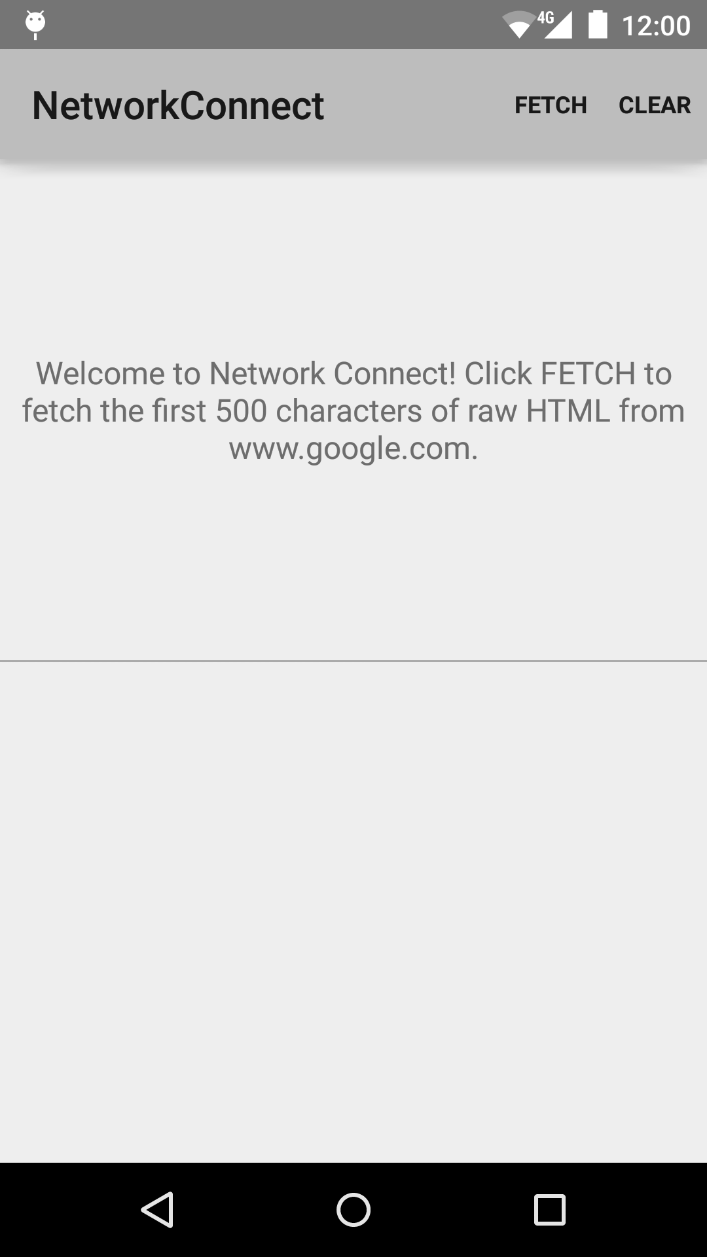
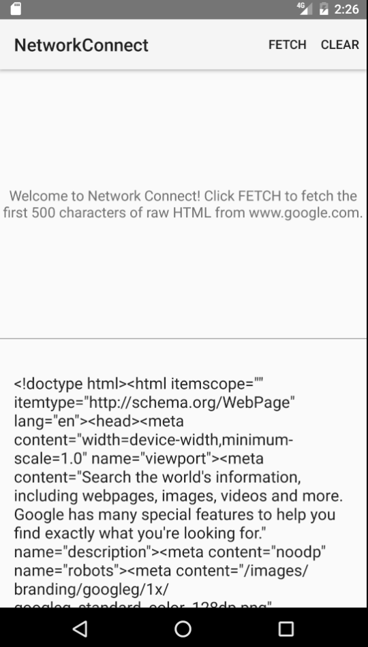
Notes:
This sample application demonstrates how to connect to the network and fetch raw HTML. It uses AsyncTask, a background task manager, to perform the network fetch on a background thread. By using AsyncTask, the app can avoid hanging on the UI thread, and instead update the UI when the response is ready. To establish the network connection, the sample uses HttpURLConnection.

Slide 67
Network Access
Create AyncTask
Download URL
HTTP Connection
Read the stream

Slide 68
private class MyAsyncTask extends AsyncTask<Params, Progress, Result>
protected void onPreExecute() {
//Code to run before executing the task
}
protected Result doInBackground(Params... params) {
//Code that you want to run in a background thread
}
protected void onProgressUpdate(Progress... values) {
//Code that you want to run to publish the progress of your task
}
protected void onPostExecute(Result result) {
//Code that you want to run when the task is complete
}
}
Notes:
AsyncTask is defined by three generic parameters: Params, Progress, and Results. Params is the type of object used to pass any task parameters to thedoInBackground() method, Progress is the type of object used to indicate task progress, and Result is the type of the task result. You can set any of these to Void if you’re not going to use them.

Slide 69
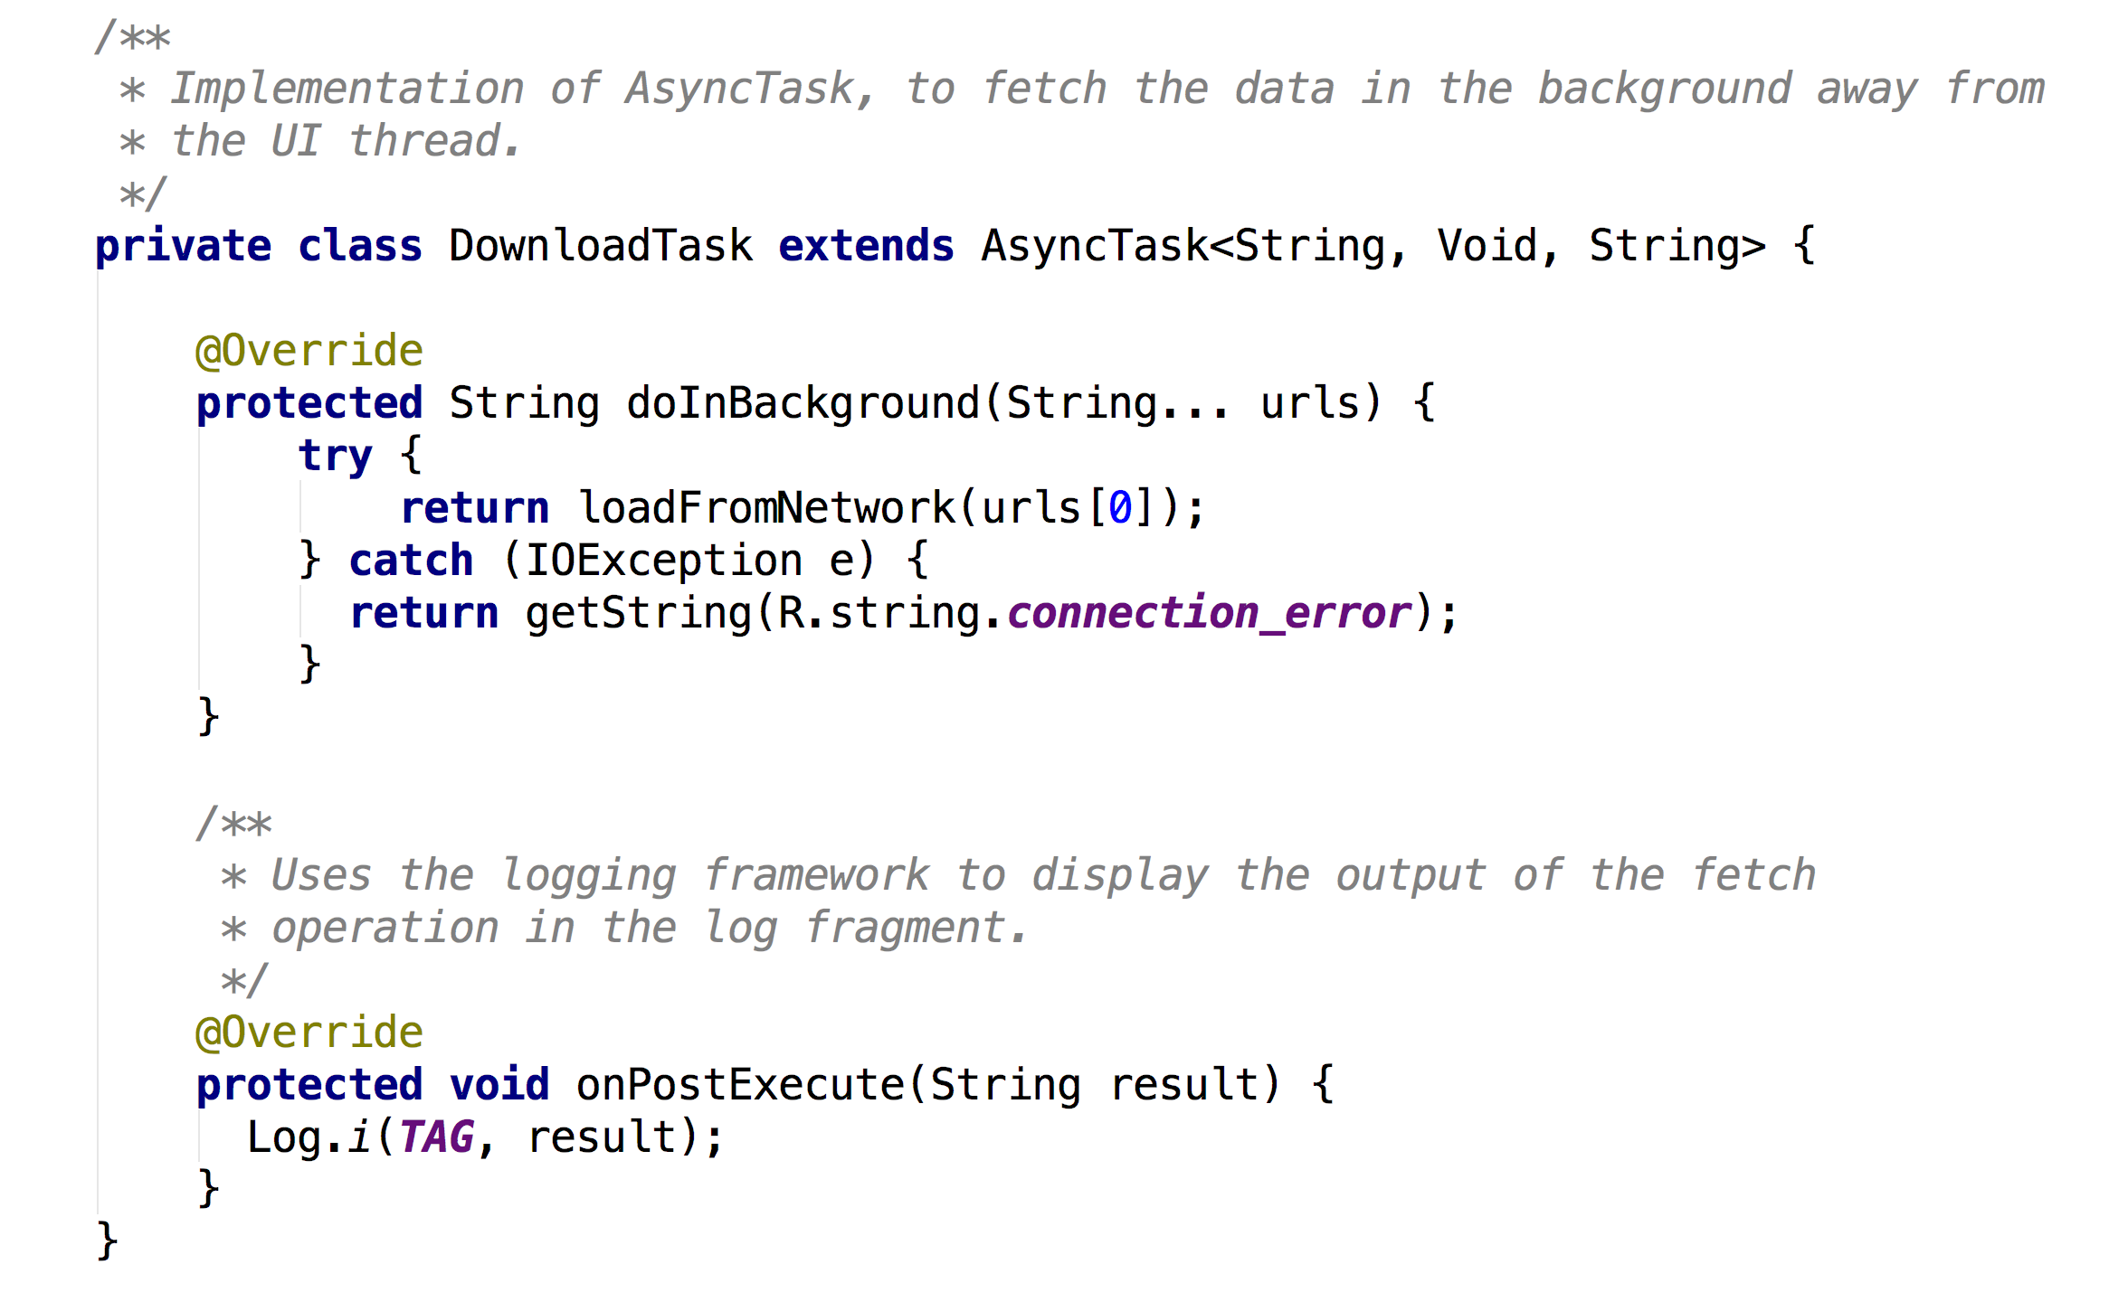
Notes:
doInBackGround calls loadFromNetwork

Slide 70
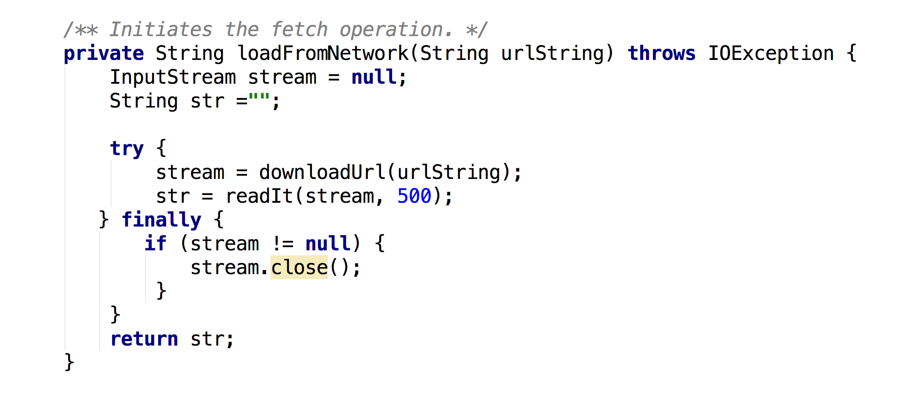
Notes:
loadFromNetwork calls downloadURL where the HTTP call is made then uses readIt to read in the stream

Slide 71
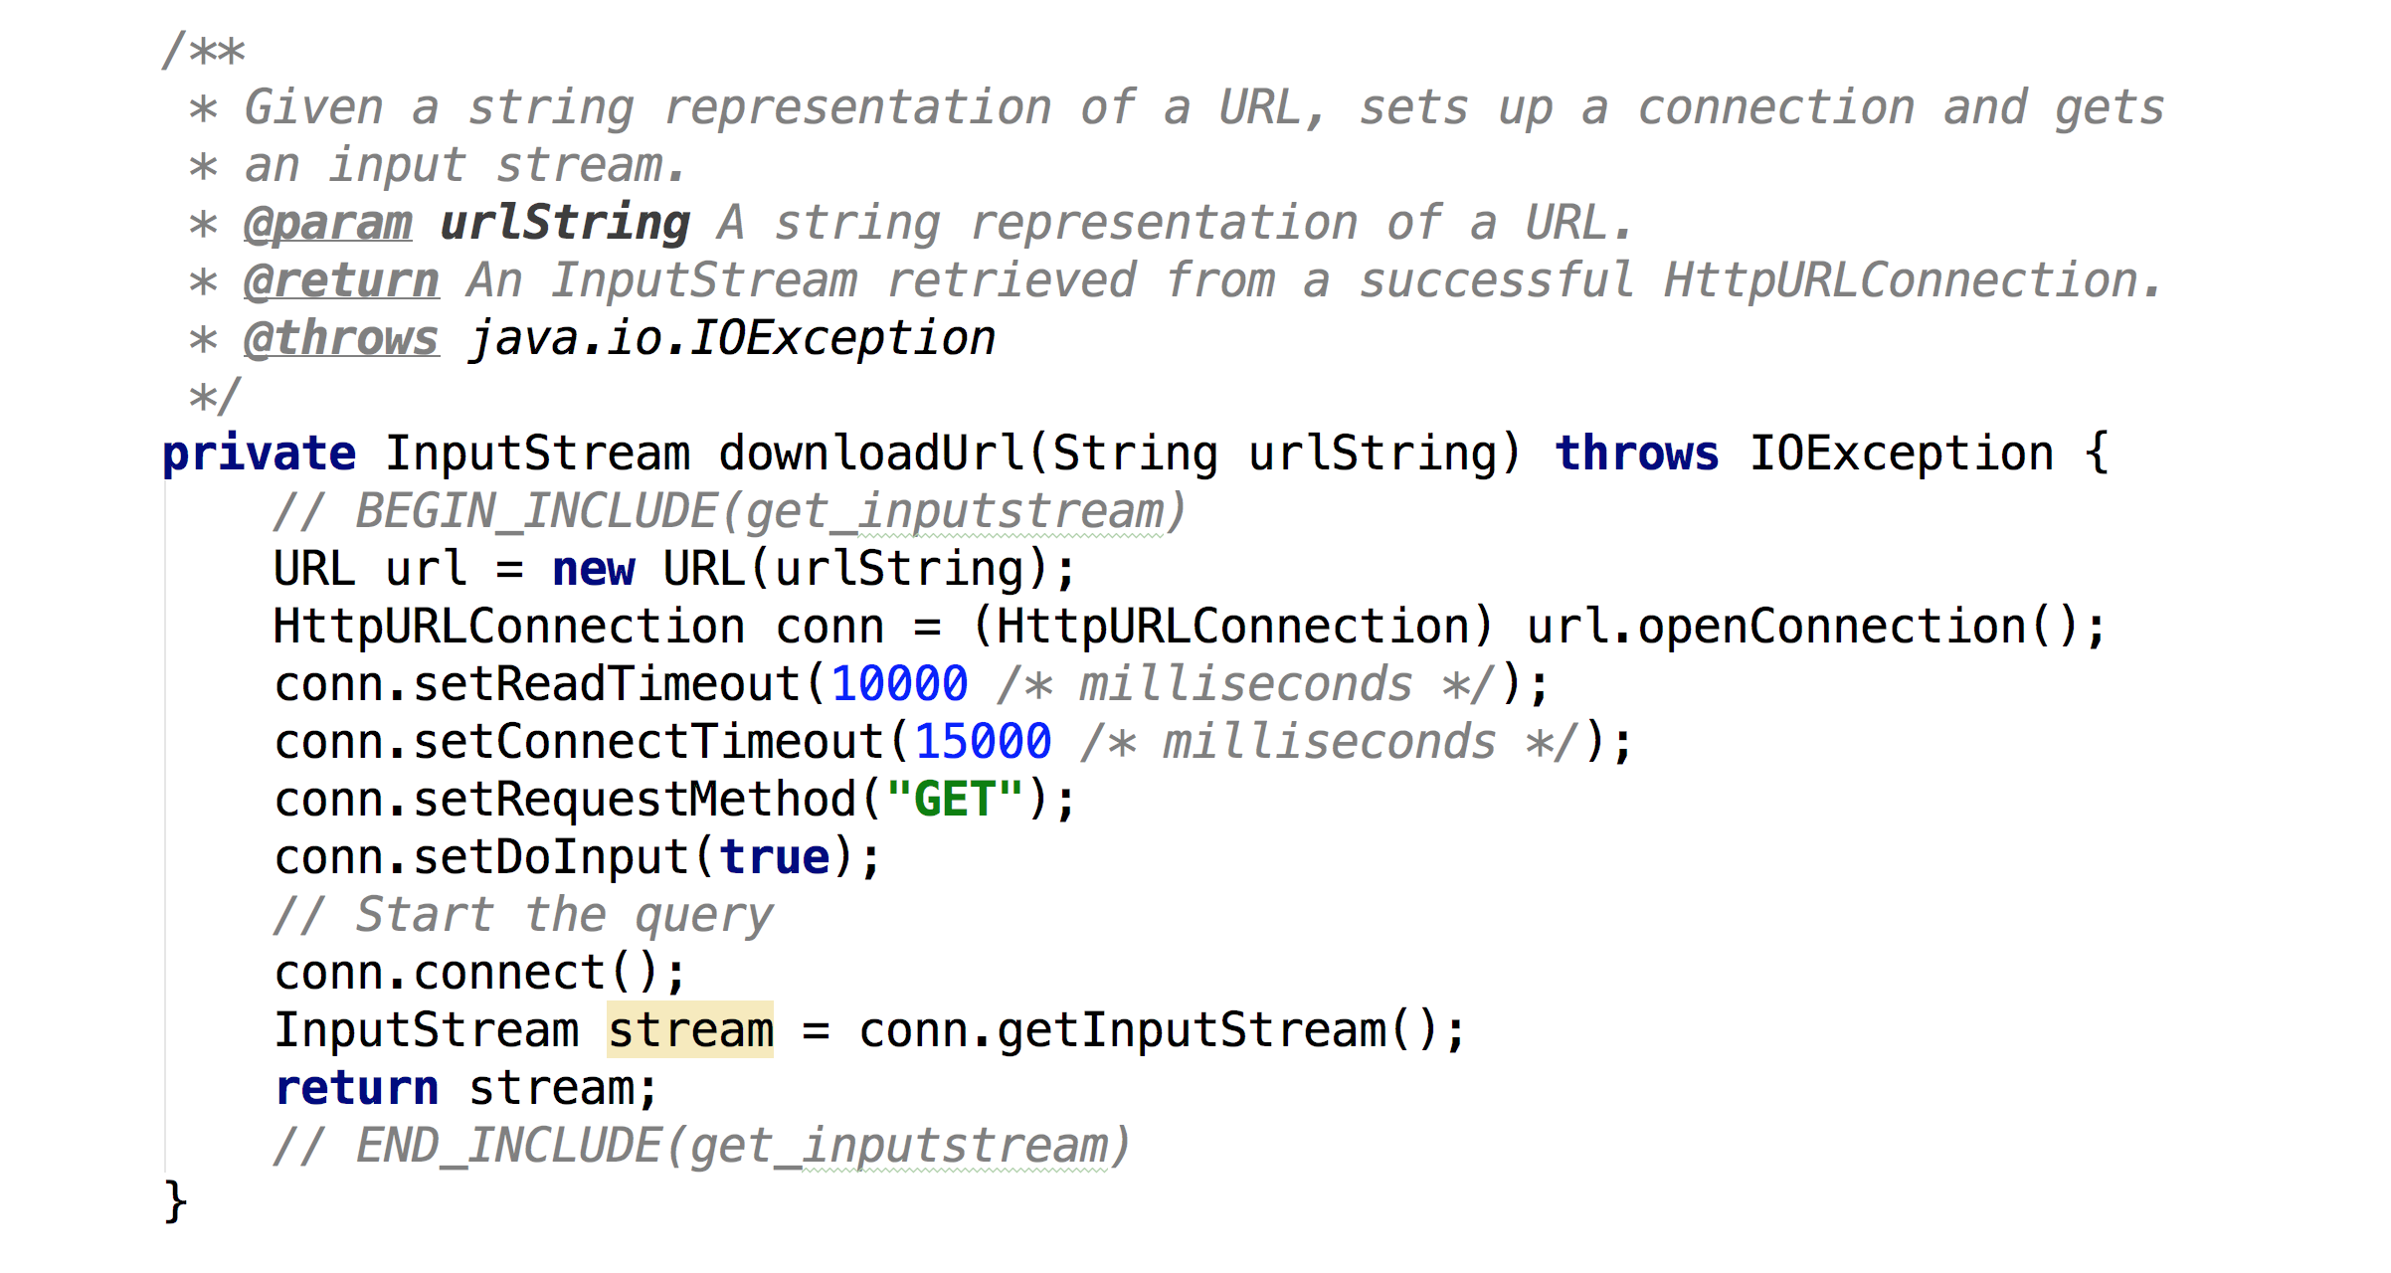
Notes:
loadFromNetwork calls downloadURL where the HTTP call is made

Slide 72
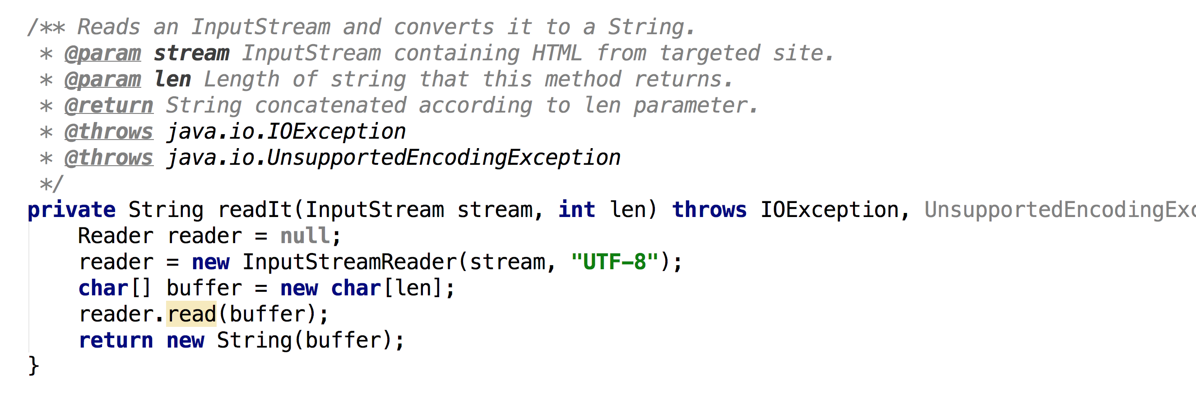
Notes:
loadFromNetwork calls downloadURL where the HTTP call is made

Slide 73
Notes:
onPostExecute then using the logging to display the output

Slide 74
Tuesday
Under the hood

